Slide 1

Internship Program by
Strucxial Projects Consultants
Launched by July 2024

Slide 2

Introduction
Welcome to a glimpse into our transformative Internship Program launched in July 2024. This initiative aimed to immerse students and recent graduates into the dynamic fields of civil engineering, construction management, and consulting. Through a carefully crafted blend of real-world projects, mentorship sessions, and skill-building workshops, our interns navigated challenges that mirror industry realities. This experience not only sharpened their technical acumen but also nurtured critical professional skills essential for their long-term success. The program stands as a testament to our belief in empowering the next generation by building tangible, competency-driven pathways for career development. Join us as we unfold the story of innovation, growth, and impact.

Slide 3
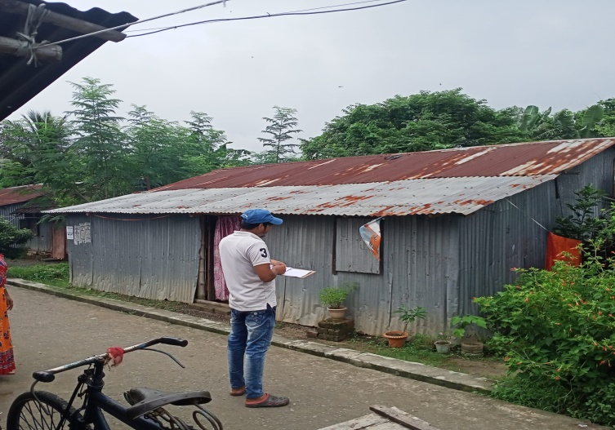
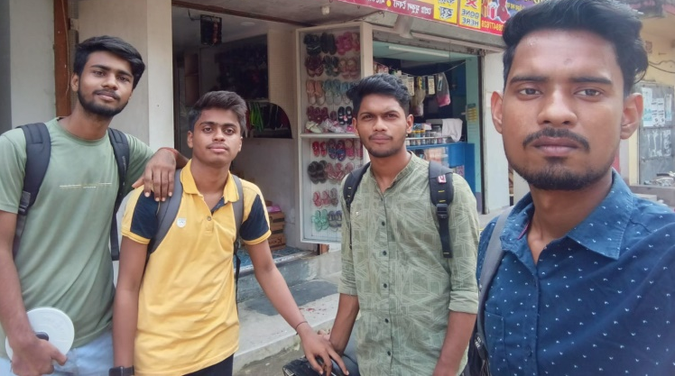

Program structure and learning opportunities
Building Skills through immersive experiences
Hands-on Projects: Interns worked on real-world projects, applying theoretical knowledge to practical challenges.
Mentorship Sessions: Guidance from experienced professionals enhanced industry understanding and career planning.
Skill-Building Workshops: Workshops focused on technical skills, soft skills, and professional development.

Slide 4

Interns’ Contribution and Imapct
Creativity, Dedication, and Fresh Perspectives
Remarkable Enthusiasm: Interns brought energy, creativity, and commitment to every task and challenge.
Collaboration with Teams: Worked alongside experienced teams, contributing valuable ideas and support.
Participation in Training: Actively engaged in technical and professional development sessions.

Slide 5

CSR Commitment to Youth Empowerment
Educating, Supporting, and Building Sustainable Futures
Empowerment Through Opportunities: Providing real-world experiences to bridge the gap between education and industry.
Educational Growth: Commitment to developing technical and professional skills for future leaders.
Community and Industry Development: Creating pathways for sustainable community growth and workforce readiness

Slide 6

Closing Ceremony Highlights
Celebrating Achievements and Offering Opportunities
Certificates Awarded: Recognized all interns for their dedication, learning, and contributions.
Employment Opportunities: Outstanding interns 3 numbers offered job placements.
Milestone Celebration: Marked the successful conclusion of our inaugural internship program.

Slide 7

Gratitude to Mentors and Team
Guiding and Supporting Our Future Leaders
Mentor Leadership: Mr. S.Maitra(Founder & Project Co-ordinator) and team leaders with Clients provided invaluable mentorship throughout the program.
Rich Learning Environment: Created supportive, challenging environments that fostered growth and innovation.
Dedication and Expertise: Staff dedicated time, knowledge, and encouragement to every intern's success.

Slide 8

Future Vision for the Internship Program
Expanding Impact, Empowering More Students
Program Expansion: Broaden reach to offer opportunities to more students nationwide.
Enhanced Skill Development: Introduce advanced workshops and project-based learning initiatives.
Sustained CSR Commitment: Invest continuously in youth empowerment and community growth.

Slide 9
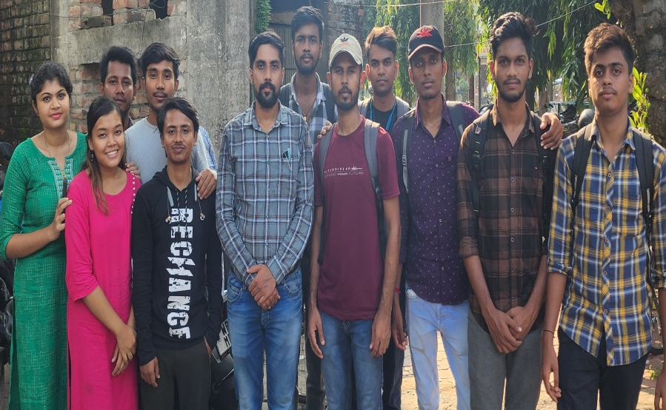

Congratulations and Closing
Celebrating Achievements and Bright Futures
Celebrating Interns' Achievements: Honoring the hard work, creativity, and growth of all participants.
Recognizing Future Potential: Confidence in the outstanding contributions these young professionals will make.
Commitment to Ongoing Support: Continuing to empower and mentor future leaders.

Slide 10

Looking Ahead Partnership for the Future
Celebrating Growth, Partnership and New Beginnings
Strengthening bonds between education, industry and community.
Commitment to continuous learning, empowerment and innovation.
Gratitude to interns, mentors and teams for their dedication and excellence

Slide 11

Thank You
.
Credit- Strucxial Projects Consultants
Website-www.struco.in

