Slide 1
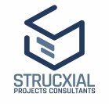

Memorandum of Understanding Signing
MoU Signing between Strucxial Projects Consultants and Swami Vivekananda University

Slide 2

Introduction
We are pleased to announce that on 22nd November 2024, Strucxial Projects Consultants successfully signed a Memorandum of Understanding (MOU) with Swami Vivekananda University. Mr. S.Maitra(Founder & Project Co-ordinator) along with Mr.H.Majumder(Senior Structure Manager) represent Strucxial Projects Consultants and Dr.S.K.Dey,Vice Chancellor represent Swami Vivekananda University. This significant agreement reflects a shared commitment to work together in advancing technical education, providing real-world training, and creating new opportunities for students to build successful careers in the engineering and technology sectors.

Slide 3
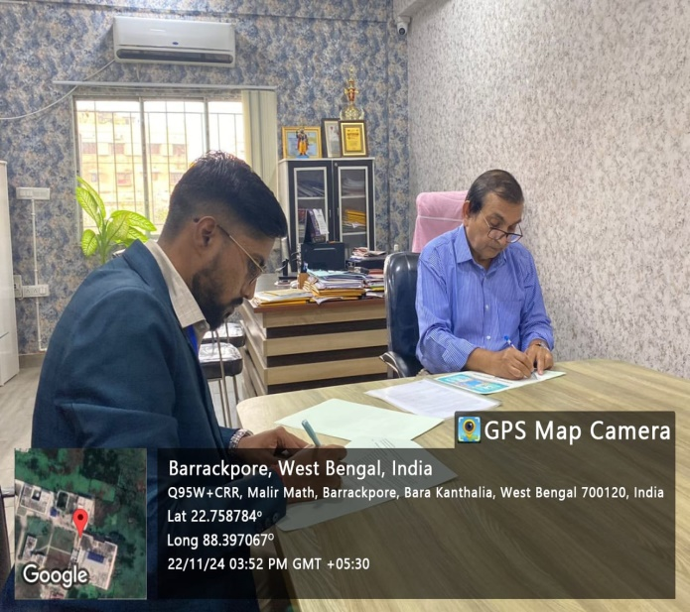

MoU Objectives
Today marks a significant milestone as Strucxial Projects Consultants and SVU join forces to drive technical education and real-world training.
Shared Vision: Commitment to advancing technical education, real-world training, and career opportunities.
Strategic Collaboration: Merging academic excellence with industry expertise for mutual growth.
Innovation and Talent Development: Empowering students through innovation-driven learning and career pathways.

Slide 4
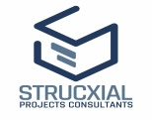
Technical Support via University Labs
Enhancing Technical Capabilities through Collaboration
Access to Advanced Labs: Strucxial Projects Consultants to utilize SVU’s state-of-the-art engineering labs for research and development.
Applied Research and Testing: Real-world investigations and project testing using cutting-edge university facilities.
Bridging Theory and Practice: Integration of academic knowledge with industrial applications to foster innovation.

Slide 5

Training Programs for Students
Bridging Academic Learning with Industry Skills
.
Specialized Training Modules: Designing and delivering practical skill-based programs aligned with industry standards.
Internships and Workshops: Hands-on learning experiences through internships, project work, and interactive sessions.
Guest Lectures by Experts: Engaging students with insights from leading industry professionals to broaden perspectives.

Slide 6
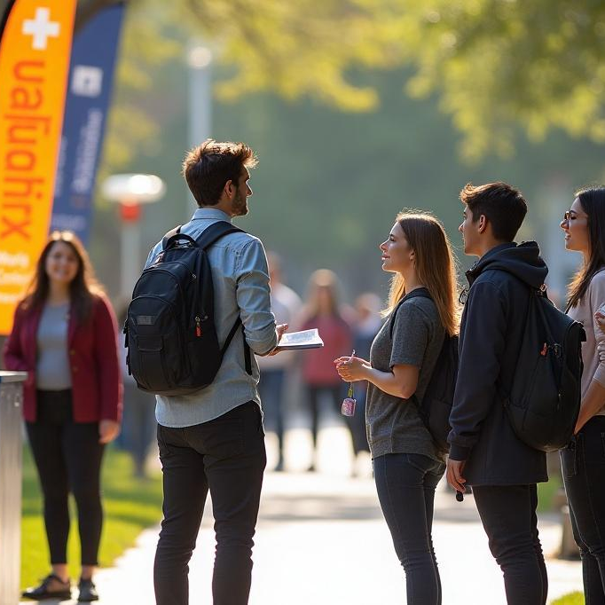

Campus Recruitment Initiatives
Unlocking Career Opportunities for Talented Students
Active Campus Engagement: Strucxial Projects Consultants to participate in Swami Vivekananda University’s campus recruitment events.
Hiring Top Talent: Identifying and recruiting high-performing students for internships and full-time positions.
Career Launchpad: Providing students with meaningful career opportunities aligned with industry growth.

Slide 7
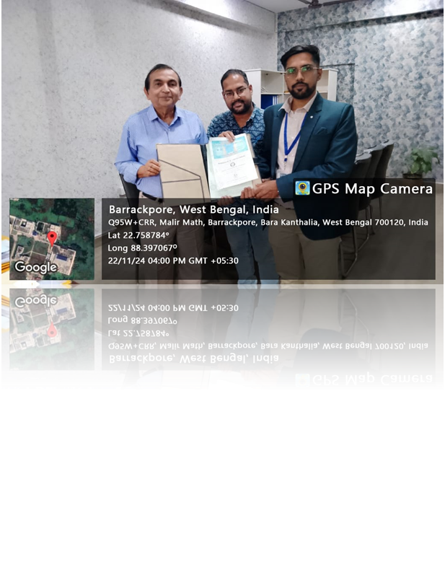

Expertise Sharing
Building a Strong Academia-Industry Knowledge Network
Joint Research Projects: Collaborative projects combining academic theory and industry applications.
Technical Seminars and Workshops: Knowledge-sharing sessions to enhance learning and foster innovation.
Expert Exchange Programs: Facilitating mobility between academia and industry for enriched experience.

Slide 8
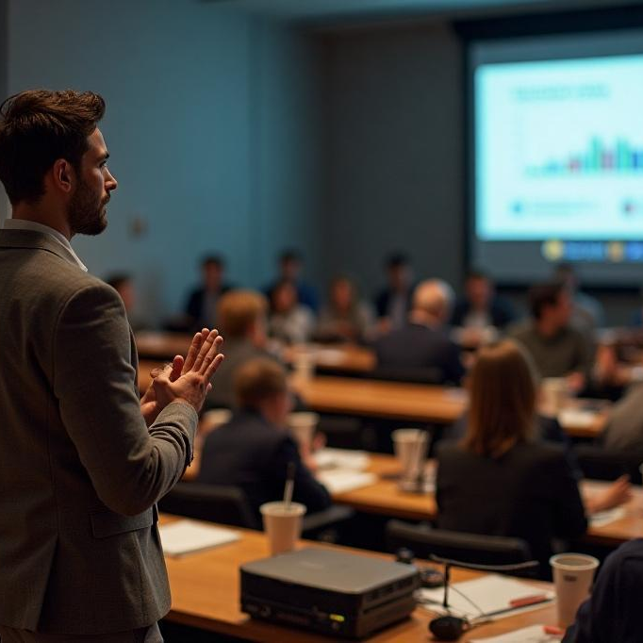

Technical Seminars
As part of the knowledge exchange framework established by the MoU, technical seminars will be organized to facilitate discussions on current trends and advancements in engineering and technology. These seminars will involve presentations from industry experts and academic leaders, providing a platform for sharing best practices, innovative ideas, and insights that can foster growth and development in both academic and professional spheres.

Slide 9
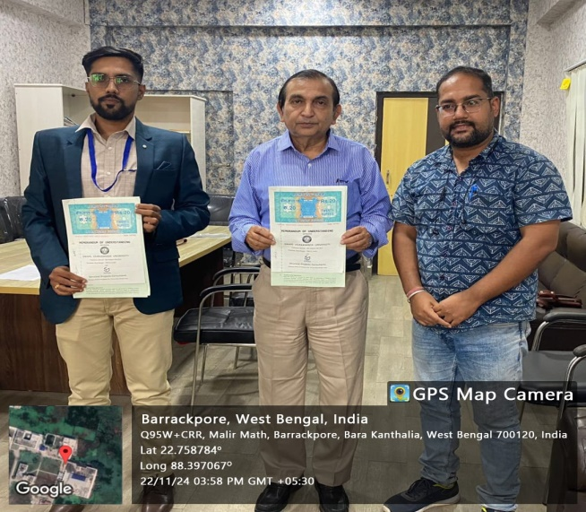
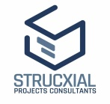
A Step Toward a Brighter Future
Corporate Social Responsibility, Innovation, and Growth
CSR and Talent Development: Driving positive social impact by empowering the next generation of innovators.
Innovation Partnership: Fostering an ecosystem where academia and industry solve real-world problems together.
Vision for Shared Success: Building sustainable growth through collaboration, research, and professional excellence.

Slide 10

Conclusions
The signing of this Memorandum of Understanding marks a pivotal step towards fostering collaboration between industry and academia. Through initiatives like technical support, professional training, and expertise sharing, both Strucxial Projects Consultants and Swami Vivekananda University are poised to create significant opportunities for students and professionals alike. This partnership is not just a commitment to elevate educational standards, but also a strategic move towards driving innovation and excellence in engineering and technology sectors.

Slide 11

Thank you
Credit- Strucxial Projects Consultants
website- www.struco.in

